Slide 1
Caliper: A Performance Profiling Library
2021 ECP Annual Meeting: Tutorial
April 12, 2021
David Boehme
Computer Scientist

Slide 2
Caliper: A Performance Profiling Library
Integrates a performance profiler into your program
Profiling is always available
Simplifies performance profiling for application end users
Common instrumentation interface
Provides program context information for other tools
Advanced profiling features
MPI, CUDA, Kokkos support; call-stack sampling; hardware counters; memory profiling
Notes:
Profiling always available: more regular than with traditional tools, including production runs
Serves as common instrumentation interface
Profiling features for HPC

Slide 3
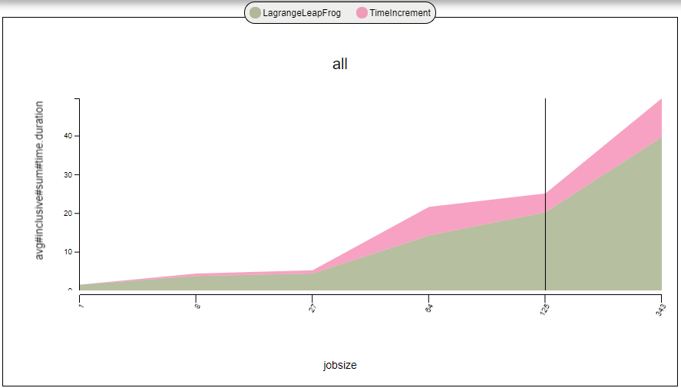
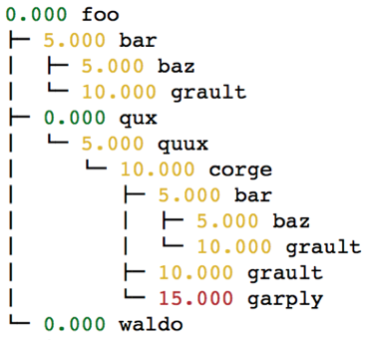
Caliper Use Cases
Lightweight always-on profiling
Performance summary report for each run
Performance debugging
Performance introspection
Comparison studies across runs
Performance regression testing
Configuration and scaling studies
Automated workflows
Performance reports
Path Min time/rank Max time/rank Avg time/rank Time %
main 0.000119 0.000119 0.000119 7.079120
mainloop 0.000067 0.000067 0.000067 3.985723
foo 0.000646 0.000646 0.000646 38.429506
init 0.000017 0.000017 0.000017 1.011303
Comparing runs
Debugging
Notes:
Caliper is entirely configurable at runtime
You can do lightweight runtime profiling with little overhead or collect more detailed data
Or turn it off entirely

Slide 4
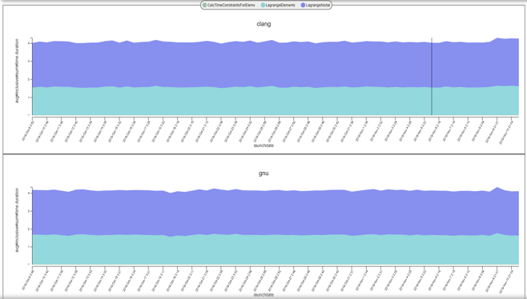

Performance Analysis with Caliper, SPOT and Hatchet
Pre-populated Jupyter notebooks
“spot” config
SPOT web frontend: Analysis of large collections of runs
#include <caliper/cali.h>
void LagrangeElements(Domain& domain, Index_t numElem)
{
CALI_CXX_MARK_FUNCTION;
// ...
Caliper: Instrumentation and Profiling
Hatchet: Call graph analysis in Python
hatchet-region-profile, hatchet-sample-profile
Notes:
Caliper fits into a larger performance analysis ecosystem with SPOT and Hatchet.
SPOT is a web-based visualization framework for analyzing large collections of runs. Several teams use it for performance regression testing, where they do nightly test runs to track performance over time.
Hatchet is a Python library for analyzing call graph data.
Caliper is the instrumentation and profiling component here, collects data for SPOT, and for Hatchet.

Slide 5
Contact & Links
GitHub repository: https://github.com/LLNL/Caliper
Documentation: https://llnl.github.io/Caliper
GitHub Discussions: https://github.com/LLNL/Caliper/discussions
Contact: David Boehme (boehme3@llnl.gov)
Notes:
Shout-out to Caliper users
Part of the ECP stack

Slide 6
Using Caliper

Slide 7
Caliper Step-by-Step
Install Caliper
Add Caliper to target code as library dependency
Instrument source-code regions
[optional] Add program metadata annotations
[optional] Add ConfigManager profiling control API
Run program with profiling configuration

Slide 8
Building and Linking the Caliper Library
Install Caliper manually (CMake build system) or with the spack package manager
Link libcaliper.so
CMake find_package() support is available
$ spack install caliper
$ g++ -o app $(OBJECTS) –L$(CALIPER_DIR)/lib64 -lcaliper
find_package(caliper)
add_executable(myapp ${SOURCES})
target_include_directories(myapp ${caliper_INCLUDE_DIR})
target_link_libraries(myapp PRIVATE caliper)
$ cmake –Dcaliper_DIR=<caliper installation dir>/share/cmake/caliper
Notes:
Spack is easy

Slide 9
Recommended CMake Build Options
$ spack install caliper +cuda+papi+mpi+libdw+libunwind+sampler
CMake Flags | Effect
-DWITH_ADIAK=On -Dadiak_DIR=<adiak install location>/lib/cmake/adiak | Program metadata recording with the Adiak library. Required for SPOT.
-DWITH_MPI=On | Enables report aggregation and MPI function profiling. Required for SPOT and loop-report.
-DWITH_PAPI=On -DPAPI_PREFIX=<papi install location> | Enables PAPI hardware counter recording.
-DWITH_SAMPLER=On -DWITH_LIBDW=On -DWITH_LIBUNWIND=On | Enables call-path sampling.
-DWITH_NVTX=On -DWITH_CUPTI=On -DCUDA_TOOLKIT_ROOT_DIR=<cuda location> | Enables CUDA profiling and annotation forwarding for NVidia NVProf/NSight tools.

Slide 10
Region Profiling: Marking Code Regions
Use annotation macros (C/C++) or functions to mark and name code regions
C/C++
Fortran
#include <caliper/cali.h>
void main() {
CALI_MARK_BEGIN(”init”);
do_init();
CALI_MARK_END(”init”);
}
USE caliper_mod
CALL cali_begin_region(‘init’)
CALL do_init()
CALL cali_end_region(‘init’)
Notes:
Core functionality in Caliper is region profiling.
Started out as a source-code instrumentation library.
It has an API to let you mark regions of interest in a program. There are high-level macros for C and C++ and functions for Fortran to do that.

Slide 11
Region Profiling: Best Practices
Be selective: Instrument high-level program subdivisions (kernels, phases, ...)
Be clear: Choose meaningful names
Start small: Add instrumentation incrementally
RAJA::ReduceSum<RAJA::omp_reduce, double> ompdot(0.0);
CALI_MARK_BEGIN(”dotproduct”);
RAJA::forall<RAJA::omp_parallel_for_exec>(RAJA::RangeSegment(0, N), [=] (int i) {
ompdot += a[i] * b[i];
});
dot = ompdot.get();
CALI_MARK_END(”dotproduct”);
Caliper annotations give meaningful names to high-level program constructs
Notes:
How do you go about instrumenting a code? Be selective: don’t instrument every function, but high-level subdivisions.
Typically have no more than 20 or so regions even in large production codes.
Annotations are not meant to pinpoint bottlenecks, but to monitor performance over time
Use options like call-path sampling if more detail is needed
Choose names that are meaningful to developers
These two point illustrate the main advantage of source code annotations: you are in control. Avoid clutter and provide meaningful names.

Slide 12
Region Profiling: Printing a Runtime Report
$ cd Caliper/build
$ make cxx-example
$ CALI_CONFIG=runtime-report ./examples/apps/cxx-example
Path Min time/rank Max time/rank Avg time/rank Time %
main 0.000119 0.000119 0.000119 7.079120
mainloop 0.000067 0.000067 0.000067 3.985723
foo 0.000646 0.000646 0.000646 38.429506
init 0.000017 0.000017 0.000017 1.011303
Set the CALI_CONFIG environment variable to access Caliper’s built-in profiling configurations
“runtime-report” measures, aggregates, and prints time in annotated code regions
Notes:
Once region annotations are in-place we can run performance measurements.
Easiest way to do that is to use one of Caliper’s built-in measurement configurations.
We can enable those with the CALI_CONFIG environment variable. Here we activate the runtime-report config.

Slide 13
Built-In Profiling Configurations
$ CALI_CONFIG=runtime-report ./examples/apps/cxx-example
Path Min time/rank Max time/rank Avg time/rank Time %
main 0.000179 0.000179 0.000179 2.054637
mainloop 0.000082 0.000082 0.000082 0.941230
foo 0.000778 0.000778 0.000778 8.930211
init 0.000020 0.000020 0.000020 0.229568
runtime-report measures and prints time in annotated regions
$ CALI_CONFIG=hatchet-region-profile ./examples/apps/cxx-example
$ ls *.json
$ region_profile.json
hatchet-region-profile records per-process time profile of annotated regions for analysis with hatchet
Built-in profiling configurations cover common performance analysis use cases
Notes:
There is a variety of built-in profiling configurations that cover common use cases

Slide 14
List of Caliper’s Built-in Profiling Configurations
Config name | Description
runtime-report | Print a time profile for annotated regions
loop-report | Print summary and time-series information for loops
mpi-report | Print time spent in MPI functions
callpath-sample-report | Print time spent in functions using call-path sampling
event-trace | Record a trace of region enter/exit events in .cali format
hatchet-region-profile | Record a region time profile for processing with hatchet or cali-query
hatchet-sample-profile | Record a sampling profile for processing with hatchet or cali-query
spot | Record a time profile for the SPOT web visualization framework
Use mpi-caliquery --help=configs to list all built-in configs and their options

Slide 15
Built-In Profiling Configurations: Configuration String Syntax
Config name specifies the kind of performance measurement
Parameters enable additional features, metrics, or output options
$ CALI_CONFIG=“runtime-report(mem.highwatermark,output=stdout)” ./examples/apps/cxx-example
Path Min time/rank Max time/rank Avg time/rank Time % Allocated MB
main 0.000179 0.000179 0.000179 2.054637 0.000047
mainloop 0.000082 0.000082 0.000082 0.941230 0.000016
foo 0.000778 0.000778 0.000778 8.930211 0.000016
init 0.000020 0.000020 0.000020 0.229568 0.000000
Most Caliper measurement configurations have optional parameters to enable additional features or configure output settings

Slide 16
Profiling Options: MPI Function Profiling
$ CALI_CONFIG=runtime-report,profile.mpi ./lulesh2.0
Path Min time/rank Max time/rank Avg time/rank Time %
MPI_Comm_dup 0.000034 0.003876 0.001999 0.10089
main 0.009013 0.010797 0.010173 0.51335
MPI_Reduce 0.000031 0.000049 0.000037 0.001886
lulesh.cycle 0.002031 0.002258 0.002085 0.105220
LagrangeLeapFrog 0.002158 0.002511 0.002227 0.112366
CalcTimeConstraintsForElems 0.015166 0.015443 0.015277 0.770922 CalcQForElems 0.058781 0.060196 0.059699 3.01254
CalcMonotonicQForElems 0.035331 0.041057 0.038496 1.942601
CommMonoQ 0.005280 0.006152 0.005544 0.279781
MPI_Wait 0.004182 0.084533 0.035324 1.78249
CommSend 0.006893 0.009062 0.008071 0.407298
MPI_Waitall 0.000986 0.001778 0.001343 0.067789
MPI_Isend 0.004564 0.005785 0.004930 0.248765
CommRecv 0.002265 0.002616 0.002341 0.118144
[...]
The profile.mpi option measures time spent in MPI functions

Slide 17
Profiling Options: CUDA Profiling
$ lrun -n 4 ./tea_leaf runtime-report,profile.cuda
Path Min time/rank Max time/rank Avg time/rank Time %
timestep_loop 0.000175 0.000791 0.000345 0.002076
[...]
total_solve 0.000105 0.000689 0.000252 0.001516
solve 0.583837 0.617376 0.594771 3.581811
dot_product 0.000936 0.001015 0.000969 0.005837
cudaMalloc 0.000060 0.000066 0.000063 0.000382
internal_halo_update 0.077627 0.079476 0.078697 0.473925
halo_update 0.158597 0.161853 0.160023 0.963685
halo_exchange 1.502106 1.572522 1.532860 9.231136
cudaMemcpy 11.840890 11.871018 11.860343 71.424929
cudaLaunchKernel 1.177454 1.230816 1.211668 7.296865
cudaMemcpy 0.470123 0.471485 0.470596 2.834008
cudaLaunchKernel 0.658269 0.682566 0.673030 4.053100
[...]
The profile.cuda option measures time in CUDA runtime API calls
Notes:
Make sure people understand config strings (passed into ConfigManager)

Slide 18
Control Profiling Programmatically: The ConfigManager API
#include <caliper/cali.h>
#include <caliper/cali-manager.h>
int main(int argc, char* argv[])
{
cali::ConfigManager mgr;
mgr.add(argv[1]);
if (mgr.error())
std::cerr << mgr.error_msg() << “\n”;
mgr.start();
// ...
mgr.flush();
}
Use ConfigManager to access Caliper’s built-in profiling configurations
Use add() to add profiling configurations (same config strings as CALI_CONFIG)
Use start() to start profiling
Use flush() to collect and write output
$ ./examples/apps/cxx-example -P runtime-report
Now we can use command-line arguments or other program inputs to enable profiling
Notes:
A unique feature of Caliper is the ability to control profiling programmatically
To do that we use the ConfigManager API. Create ConfigManager object. Add configurations (using same config strings as for CALI_CONFIG)
This again gives you more control over profiling. Use program-specific inputs like command line or input files to configure profiling.

Slide 19
ConfigManager vs. CALI_CONFIG vs. Manual Configuration
Use ConfigManager or CALI_CONFIG for Caliper’s built-in measurement configurations
ConfigManager allows use of program-specific inputs (e.g., command-line arguments)
You can create custom measurement and report configurations manually
$ CALI_CONFIG=runtime-report ./examples/apps/cxx-example
$ ./examples/apps/cxx-example -P runtime-report
$ export CALI_SERVICES_ENABLE=aggregate,event,mpi,mpireport,timestamp
$ export CALI_MPIREPORT_CONFIG=“SELECT
min(sum#time.duration) as \”Min Time/rank\”,
max(sum#time.duration) as \”Max Time/rank\”,
avg(sum#time.duration) as \”Avg Time/rank\”
GROUP BY prop:nested FORMAT tree”
$ ./examples/apps/cxx-example

Slide 20
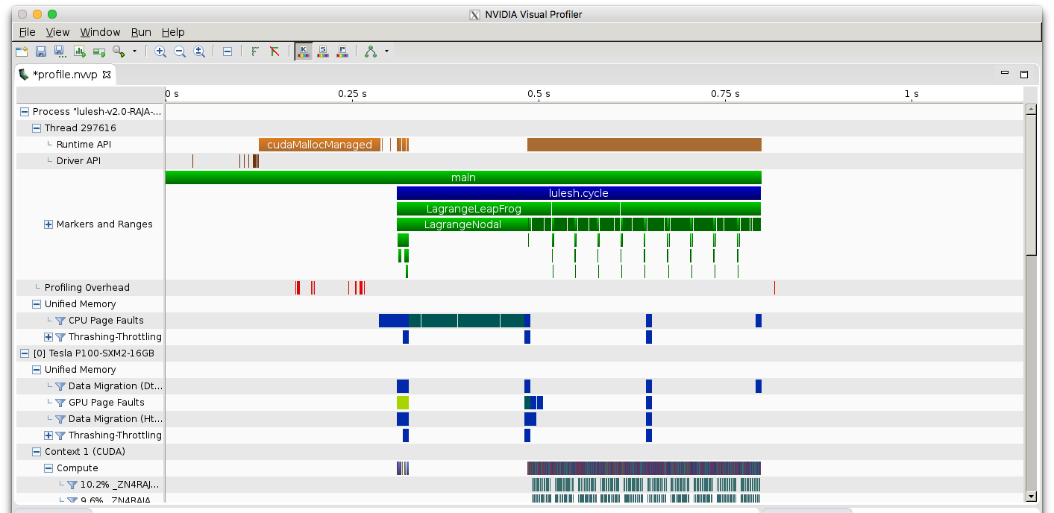
Forwarding Annotations to Third-Party Tools
$ CALI_CONFIG=nvtx nvprof <nvprof-opts> ./app
Caliper regions shown in NVVP
The nvtx config forwards annotations to NVidia’s NVTX API
Notes:
Many tools have their own source-code annotation APIs. We provide adapters for them.

Slide 21
Loop Profiling: Marking Loops and Loop Iterations
C++
CALI_MARK_CXX_MARK_LOOP_BEGIN(mainloop_id, ”mainloop”);
for (int i = 0; i < N; ++i) {
CALI_CXX_MARK_LOOP_ITERATION(mainloop_id, i);
// ...
}
CALI_CXX_MARK_LOOP_END(mainloop_id);
Mark loops and iterations to support loop profiling options
Generally, it’s best to only annotate outer loops (e.g., the main time step loop)
Notes:
In addition to region annotations, we also have annotations for loops and loop iterations
Similar to region profiling, be selective

Slide 22
Loop Profiling: Loop and Iteration Summary
$ ./examples/apps/cxx-example 5000 –P loop-report
Loop summary:
------------
Loop Iterations Time (s) Iter/s (min) Iter/s (max) Iter/s (avg)
mainloop 5000 6.815763 380.539973 2462.197671 723.821101
Iteration summary (mainloop):
-----------------
Block Iterations Time (s) Iter/s
0 1232 0.500366 2462.197671
1232 575 0.500723 1148.339501
1807 447 0.500756 892.650313
2254 377 0.501059 752.406403
2631 333 0.501320 664.246390
2964 301 0.501534 600.158713
3265 277 0.500940 552.960434
3542 256 0.502077 509.881950
[...]
loop-report config prints time in instrumented loops
Notes:
The loop-report config prints summary for each loop with the time and number of iterations in the loop
Also prints an iteration summary
Notice it doesn’t print every iteration but instead groups them into blocks
We can control blocks in two ways

Slide 23
Loop Profiling: Measurement Intervals
Loop measurement intervals can be time or iteration based (“measure every x seconds” or “measure every N iterations”)
$ ./examples/apps/cxx-example 5000 –P loop-report(iteration_interval=500)
Block Iterations Time (s) Iter/s
0 500 0.110812 4512.146699
500 500 0.244453 2045.382957
1000 500 0.378453 1321.168018
1500 500 0.532856 938.339814
2000 500 0.660435 757.076775
2500 500 0.785368 636.644223
[...]
Measuring every 500 iterations
Notes:
First, measurement interval

Slide 24
Loop Profiling: Iteration Blocks
Output adapts to any loop length: Iterations are grouped into blocks so that only N blocks are shown (default: 20)
$ ./examples/apps/cxx-example 5000 –P loop-report(iteration_interval=500,timeseries.maxrows=3)
Block Iterations Time (s) Iter/s
0 2000 1.294308 1545.227257
1666 1500 2.359132 635.827075
3332 1500 3.484032 430.535655
Group iterations into three blocks
loop-report(iteration_interval=1,timeseries.maxrows=0)
Measure and show every iteration

Slide 25
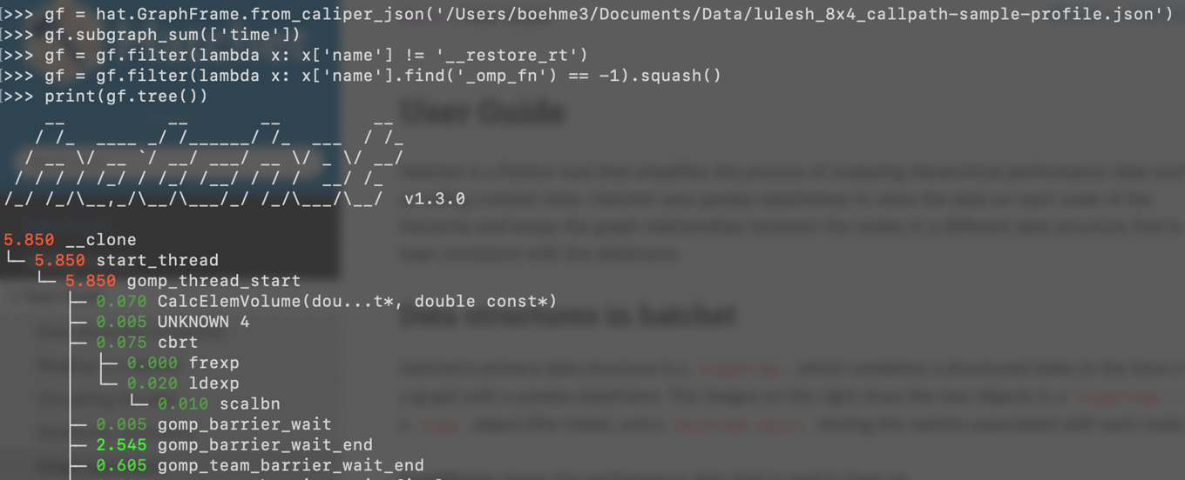
Call Graph Analysis with the Hatchet Python Library
Caliper records data for hatchet with hatchet-region-profile or hatchet-sample-profile
$ CALI_CONFIG=hatchet-sample-profile srun -n 8 ./lulesh2.0
Hatchet allows manipulation, computation, comparison, and visualization of call graph data

Slide 26
Manual Configuration Allows Custom Analyses
cali-query -q "select alloc.label#cupti.fault.addr as Pool,
cupti.uvm.kind as UVM\ Event,
scale(cupti.uvm.bytes,1e-6) as MB,
scale(cupti.activity.duration,1e-9) as Time
group by
prop:nested,alloc.label#cupti.fault.addr,cupti.uvm.kind
where cupti.uvm.kind format tree” trace.cali
caliper.config
CALI_SERVICES_ENABLE=alloc,cupti,cuptitrace,mpi,trace,recorder
CALI_ALLOC_RESOLVE_ADDRESSES=true
CALI_CUPTI_CALLBACK_DOMAINS=sync
CALI_CUPTITRACE_ACTIVITIES=uvm
CALI_CUPTITRACE_CORRELATE_CONTEXT=false
CALI_CUPTITRACE_FLUSH_ON_SNAPSHOT=true
Path
main
solve
TIME_STEPPING
enforceBC
CURVI in EnforceBC
CurviCartIC
CurviCartIC::PART 3 Pool UVM Event MB Time
curvilinear4sgwind UM_pool pagefaults.gpu 2.806946
curvilinear4sgwind UM_pool HtoD 7862.747136 0.232238
curvilinear4sgwind UM_pool_temps pagefaults.gpu 0.130167
curvilinear4sgwind UM_pool DtoH 9986.441216 0.378583
curvilinear4sgwind UM_pool pagefaults.cpu
Mapping CPU/GPU unified memory transfer events to Umpire memory pools in SW4
Notes:
If none of the built-in configurations do what you want, you can configure Caliper manually.
Caliper comes with many service modules that implement some specific measurement functionality. You can compose and configure these in many different ways.
Here we’re recording unified memory data transfers between CPU and GPU memory, and map those events back to named memory buffers and code regions.
This produces a trace, and we can use a query tool with its own query language to produce this report.
So Caliper provides the building blocks for you to create very specific performance analysis solutions.

Slide 27
Caliper Output Formats and Processing Workflows
*-report configs
Human-readable report
SPOT web frontend
spot
.cali
hatchet-region-profile
hatchet-sample-profile
.json
Hatchet
cali-query -q ...
recorder (manual config)
event-trace
spot
.cali
caliper-reader
Python library
Notes:
Overall, there is a wide variety of ways to record and analyze performance data with Caliper

Slide 28
Recording Data for SPOT

Slide 29
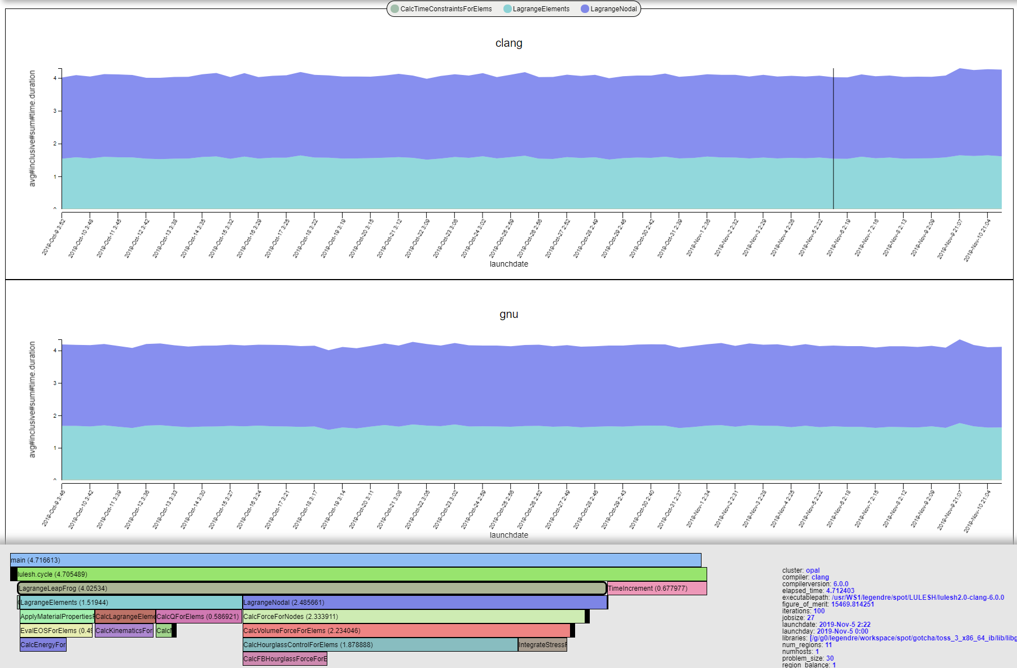
Recording Data for SPOT with Caliper and Adiak
#include <caliper/cali.h>
void LagrangeElements(Domain& domain, Index_t numElem)
{
CALI_CXX_MARK_FUNCTION;
// ...
Region instrumentation
SPOT
Web
GUI
adiak::clustername();
adiak::jobsize();
adiak::value("iterations", opts.its);
adiak::value("problem_size", opts.nx);
adiak::value("num_regions", opts.numReg);
Metadata
collection
[adiak]
cali::ConfigManager mgr;
mgr.add(opts.caliperConfig.c_str());
mgr.start();
// ...
mgr.flush();
Profile data
(.cali)
Experiment directory
Caliper configuration
$ ./app –P spot
Run program with the “spot” profiling config
Notes:
This is the overall workflow
Left side shows program modifications, right side runtime actions
First of all, add region annotations. SPOT primarily works with region time profiles.
Second, we want to record metadata describing a program run. Why? With SPOT, we look not at individual program runs, but whole sets. However, it makes little sense for example to compare 1D run with 3D run.
Also, we want to do performance studies with this metadata. For example, how is the performance when Bob runs vs. developers. We want to do scaling studies with different MPI job sizes. Compare performance of different program inputs or different build configurations.
To collect this information, we have developed a library called adiak, and it can collect both common and program-specific data and feed it into Caliper.
Finally, we need a way to configure Caliper, either ConfigManager or CALI_CONFIG.
Run program with the SPOT config, and put resulting file into a common experiment directory.
Typically done inside a CI script. Not much needed: Run designated tests with SPOT config and move the resulting .cali fiiles.

Slide 30
Recording Program Metadata with the Adiak Library
TeaLeaf_CUDA example [C++]
#include <adiak.hpp>
adiak::user();
adiak::launchdate();
adiak::jobsize();
adiak::value("end_step", readInt(input, "end_step"));
adiak::value(”halo_depth", readInt(input, ”halo_depth"));
if (tl_use_ppcg) {
adiak::value(“solver”, “PPCG”);
// [...]
Use built-in Adiak functions to collect common metadata
Use key:value functions to collect program-specific data
Use the Adiak C/C++ library to record program metadata
Environment info (user, launchdate, system name, ...)
Program configuration (input problem description, problem size, ...)
Enables performance comparisons across runs. Required for SPOT.
Notes:
Let’s talk a bit more about adiak. C/C++ library for recording run metadata. Two kinds of functions: Built-in for common metadata, key-value for custom.
Kind of information to record depends on use case. Typically program input/config, build config, figure-of-merit.

Slide 31
Adiak: Built-in Functions for Common Metadata
adiak_user(); /* user name */
adiak_uid(); /* user id */
adiak_launchdate(); /* program start time (UNIX timestamp) */
adiak_executable(); /* executable name */
adiak_executablepath(); /* full executable file path */
adiak_cmdline(); /* command line parameters */
adiak_hostname(); /* current host name */
adiak_clustername(); /* cluster name */
adiak_job_size(); /* MPI job size */
adiak_hostlist(); /* all host names in this MPI job */
adiak_walltime(); /* wall-clock job runtime */
adiak_cputime(); /* job cpu runtime */
adiak_systime(); /* job sys runtime */
Adiak comes with built-in functions to collect common environment metadata
SPOT requires at least launchdate

Slide 32
Adiak: Recording Custom Key-Value Data in C++
C++
#include <adiak.hpp>
vector<int> ints { 1, 2, 3, 4 };
adiak::value(“myvec”, ints);
adiak::value(“myint”, 42);
adiak::value(“mydouble”, 3.14);
adiak::value(“mystring”, “hi”);
adiak::value(“mypath”, adiak::path(“/dev/null”));
adiak::value(“compiler”, adiak::version(“gcc@8.3.0”));
Adiak supports many basic and structured data types
Strings, integers, floating point, lists, tuples, sets, ...
adiak::value() records key:value pairs with overloads for many data types
Notes:
Discuss weirdly complex types

Slide 33
Adiak: Recording Custom Key-Value Data in C
C
#include <adiak.h>
int ints[] = { 1, 2, 3, 4 };
adiak_nameval(“myvec”, adiak_general, NULL, “[%d]”, ints, 4);
adiak_nameval(“myint”, adiak_general, NULL, “%d”, 42);
adiak_nameval(“mydouble”, adiak_general, NULL, “%f”, 3.14);
adiak_nameval(“mystring”, adiak_general, NULL, “%s”, “hi”);
adiak_nameval(“mypath”, adiak_general, NULL, “%p”, “/dev/null”);
adiak_nameval(“compiler”, adiak_general, NULL, “%v”, “gcc@8.3.0”);
In C, adiak_nameval() uses printf()-style descriptors to determine data types

Slide 34
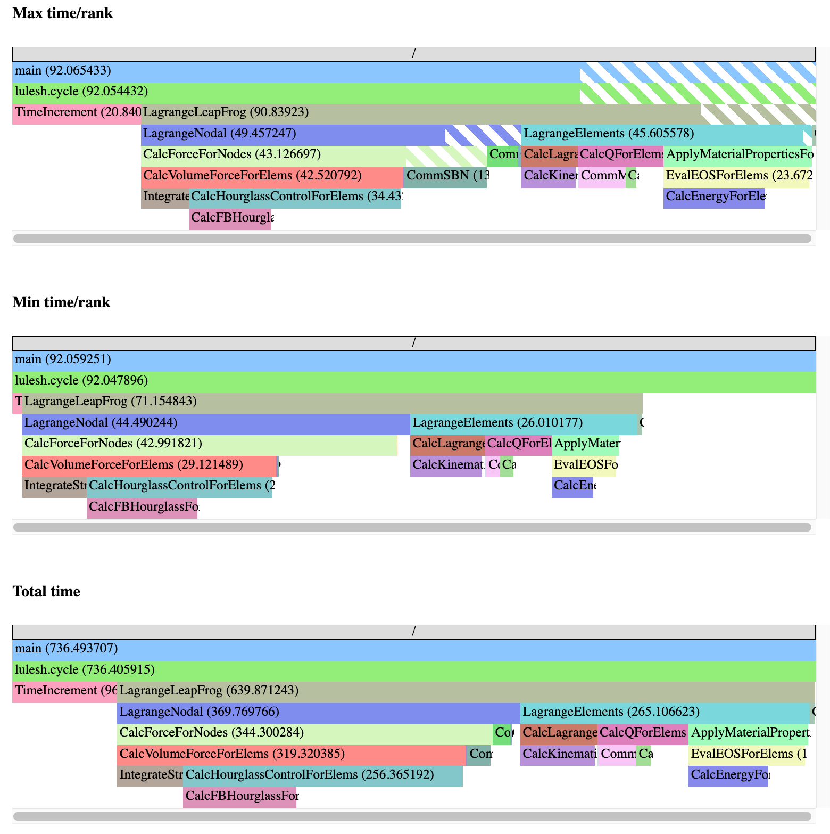
The spot config: Region Profiling
$ CALI_CONFIG=spot,profile.mpi ./lulesh2.0
$ ls *.cali
210304-17175150010.cali
“spot” records and aggregates time spent in instrumented regions, like runtime-report
Supports many profiling options (e.g., MPI function profiling)
Collect profiling output (.cali files) in a directory for analysis in SPOT
SPOT region profile flame graphs
Notes:
To record data for SPOT, run with the spot config. Records time statistics for annotated regions, just like runtime-report.

Slide 35
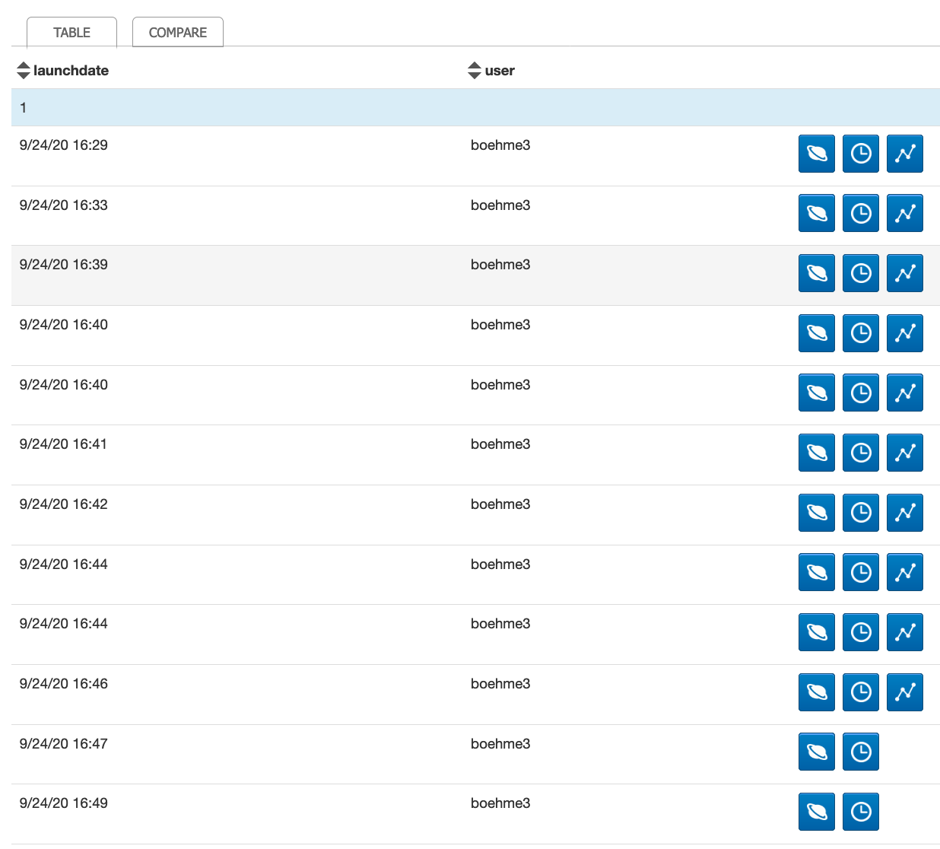
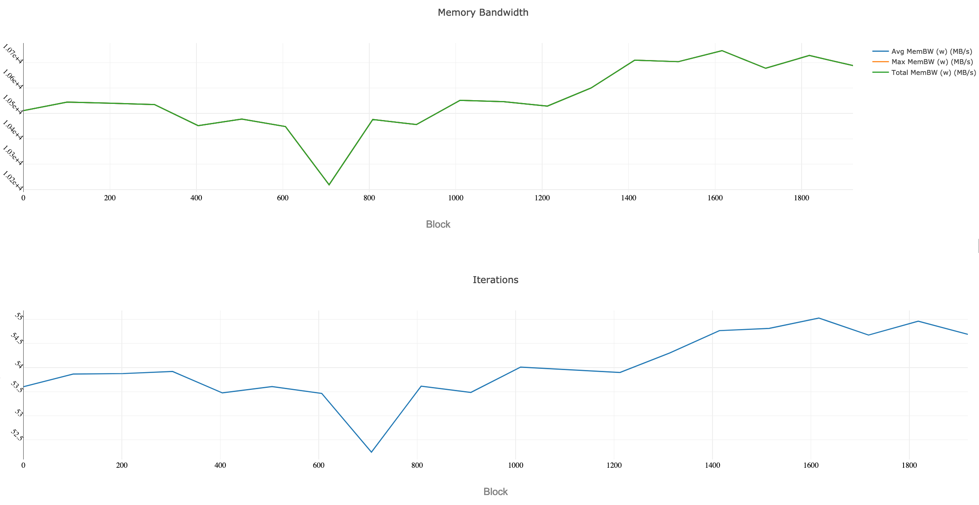
The spot config: Loop Profiling
$ CALI_CONFIG=spot,timeseries=true,timeseries.metrics=mem.bandwidth ./app
Enable the “timeseries” option to record loop profiles for SPOT
Use “timeseries.metrics” to enable metric options for the loop profile
Timeseries data available
SPOT loop profile visualization
Notes:
Finally, it’s possible to record loop profiles for SPOT as well.

Slide 36
Example: Caliper and Adiak in LULESH
Notes:
Walk through LULESH proxy app, which we use for the SPOT and Hatchet tutorial.

Slide 37
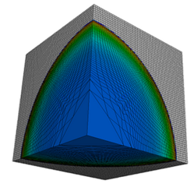
Modified LULESH Proxy App with Caliper and Adiak Support
https://github.com/daboehme/LULESH/tree/adiak-caliper-support
$ mpirun -n 8 ./lulesh2.0 -P runtime-report,profile.mpi
Path Min time/rank Max time/rank Avg time/rank Time %
MPI_Comm_dup 0.000034 0.003876 0.001999 0.10089
main 0.009013 0.010797 0.010173 0.51335
MPI_Reduce 0.000031 0.000049 0.000037 0.001886
lulesh.cycle 0.002031 0.002258 0.002085 0.105220
LagrangeLeapFrog 0.002158 0.002511 0.002227 0.112366
CalcTimeConstraintsForElems 0.015166 0.015443 0.015277 0.770922
CalcQForElems 0.058781 0.060196 0.059699 3.01254
CalcMonotonicQForElems 0.035331 0.041057 0.038496 1.942601
CommMonoQ 0.005280 0.006152 0.005544 0.279781
MPI_Wait 0.004182 0.084533 0.035324 1.78249
CommSend 0.006893 0.009062 0.008071 0.407298
MPI_Waitall 0.000986 0.001778 0.001343 0.067789
MPI_Isend 0.004564 0.005785 0.004930 0.248765
CommRecv 0.002265 0.002616 0.002341 0.118144
[...]

Slide 38
LULESH Example: Region Annotations
void CalcLagrangeElements(Domain& domain)
{
CALI_CXX_MARK_FUNCTION;
...
Function annotation in LULESH
Top-level functions provide meaningful basis for performance analysis in LULESH
Annotated 17 out of 39 computational functions and 5 communication functions

Slide 39
LULESH Example: Main Loop Annotation
CALI_CXX_MARK_LOOP_BEGIN(cycleloop, "lulesh.cycle");
while((locDom->time() < locDom->stoptime()) && (locDom->cycle() < opts.its)) {
CALI_CXX_MARK_LOOP_ITERATION(cycleloop, locDom->cycle());
// ...
}
CALI_CXX_MARK_LOOP_END(cycleloop);
Main loop annotation in LULESH
Annotation of the main time-stepping loop and iterations for loop profiling

Slide 40
LULESH Example: Initialization and ConfigManager
adiak::init(adiak_comm_p);
cali::ConfigManager mgr; if (!opts.caliperConfig.empty())
mgr.add(opts.caliperConfig.c_str());
if (mgr.error())
std::cerr << "Caliper config parse error: " << mgr.error_msg() << std::endl;
mgr.start();
// ...
mgr.flush();
MPI_Finalize();
ConfigManager setup in LULESH
Profiling control via ConfigManager API
Modified LULESH command-line parsing code to read Caliper config string (not shown)

Slide 41
LULESH Example: Recording Metadata With Adiak
void RecordGlobals(const cmdLineOpts& opts, int num_threads)
{
adiak::user();
adiak::launchdate();
adiak::executablepath();
adiak::libraries();
adiak::cmdline();
adiak::clustername();
adiak::jobsize();
adiak::value("threads", num_threads); adiak::value("iterations", opts.its);
adiak::value("problem_size", opts.nx);
adiak::value("num_regions", opts.numReg);
adiak::value("region_cost", opts.cost);
adiak::value("region_balance", opts.balance);
}
void VerifyAndWriteFinalOutput(...)
{
// ...
adiak::value("elapsed_time", elapsed_time);
adiak::value("figure_of_merit", 1000.0/grindTime2);
}
Recording global performance metrics at program end
Recording environment and LULESH config
Adiak calls record environment info, LULESH configuration options, and global performance metrics

Slide 42
LULESH Example: Build System Modifications
find_package(caliper REQUIRED)
find_package(adiak REQUIRED)
# ...
add_executable(${LULESH_EXEC} ${LULESH_SOURCES})
target_include_directories(${LULESH_EXEC} PRIVATE ${caliper_INCLUDE_DIR} ${adiak_INCLUDE_DIRS})
target_link_libraries(${LULESH_EXEC} caliper adiak)
CMakeLists.txt
Using caliper and adiak find_package() support in LULESH CMake script

Slide 43
Notes:
Future work

